Slide 1


Laptop Price Prediction Analysis
This presentation explores a dataset of laptop prices and specifications. We'll examine key factors influencing laptop pricing through data visualization and machine learning models.
Group 6
• Meera Palanivel • Praveena Venu • Niyati Mudliar • Abhishu Tailor • SasiKumar • Padmavathy V
• Nithin Thomas

Slide 2
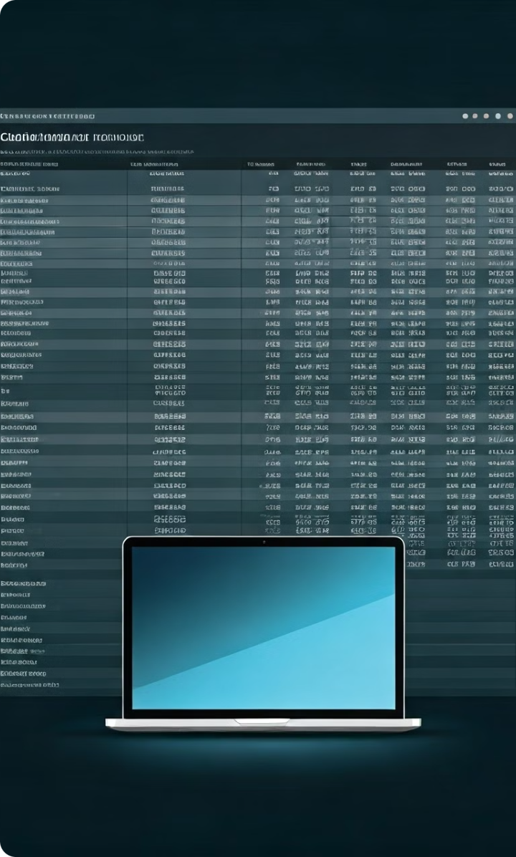
Dataset Overview
823 Laptops
The dataset contains information on 823 laptop models.
19 Features
Each laptop has 19 features including brand, processor, RAM, storage, and more.
Price Target
The goal is to predict laptop prices based on their specifications.

Slide 3
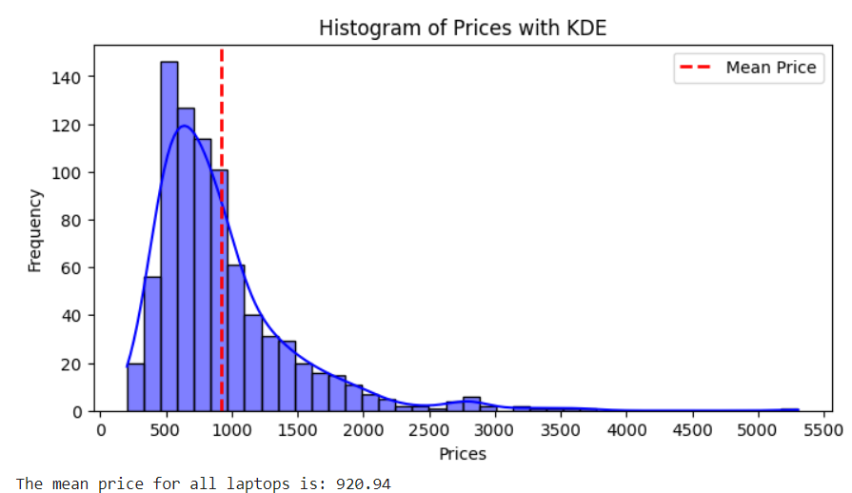
Price Distribution
The histogram shows laptop prices are right-skewed. Most laptops are in the lower price range, with fewer high-end expensive models.

Slide 4
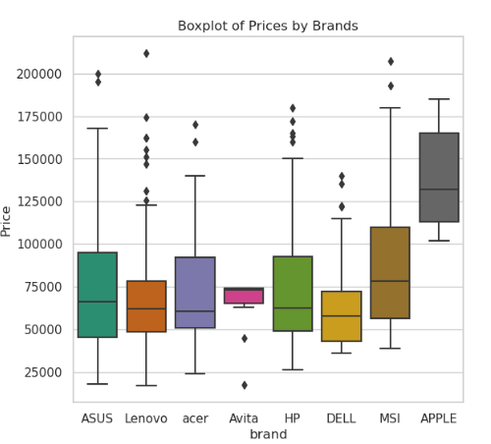
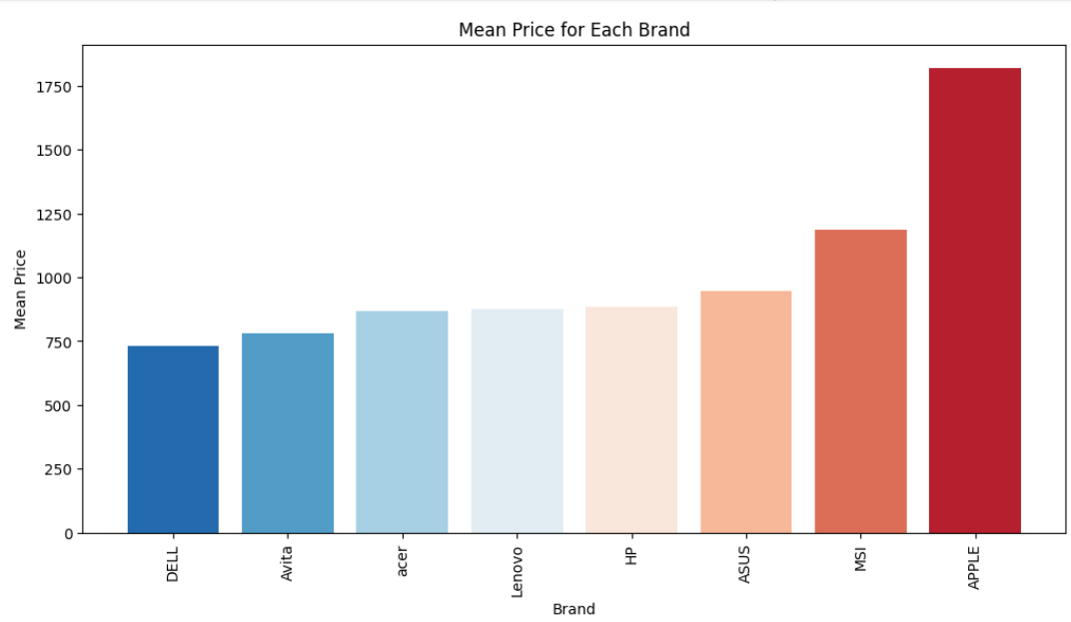
Brand Price Comparison
Budget Brands
Mid-Range
Premium
Brands like Avita and Acer have lower average prices.
Lenovo, HP, and ASUS fall in the middle price range.
Apple has the highest average price among all brands.

Slide 5
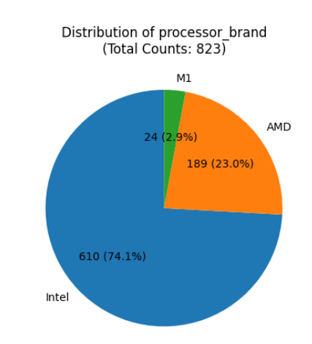
Processor Brands
The pie chart shows Intel dominates the processor market in this dataset. AMD and Apple's M1 make up smaller portions.

Slide 6
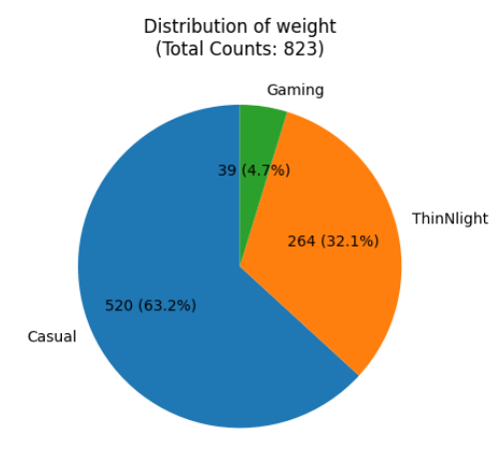
Laptop Weight Categories
1
Casual
Most laptops fall into the "Casual" weight category.
2
ThinNLight
A significant portion are classified as "ThinNLight" for portability.
3
Gaming
A small percentage are heavier "Gaming" laptops.

Slide 7
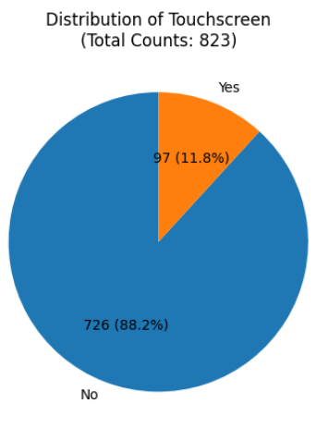
Touchscreen vs Non-Touchscreen
The vast majority of laptops in the dataset do not have touchscreens. Touchscreen models are a small minority.

Slide 8
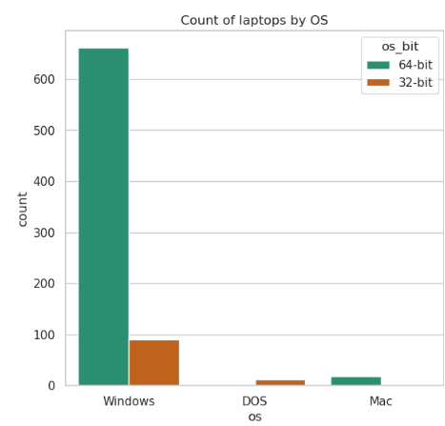
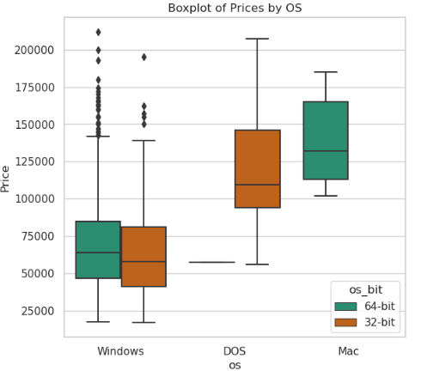
Operating System Distribution
1
Windows Dominance
Windows is by far the most common operating system.
2
Mac OS
Mac OS has a small but significant presence.
3
DOS
A few laptops come with DOS, likely for customization.

Slide 9
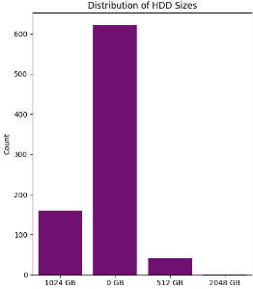
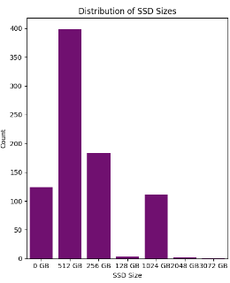
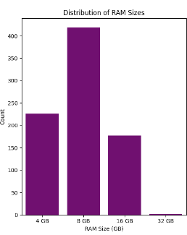
Storage Options
HDD
SSD
Hybrid
Traditional hard drives are still common, with 1TB being popular.
Solid state drives are increasingly prevalent, with 512GB being a common size.
Some laptops combine both HDD and SSD for balanced storage.

Slide 10
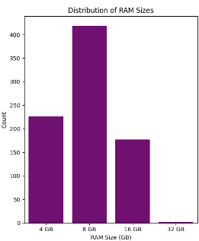
RAM Configurations
8GB is the most common RAM size, followed by 16GB. High-end laptops offer 32GB or more.

Slide 11
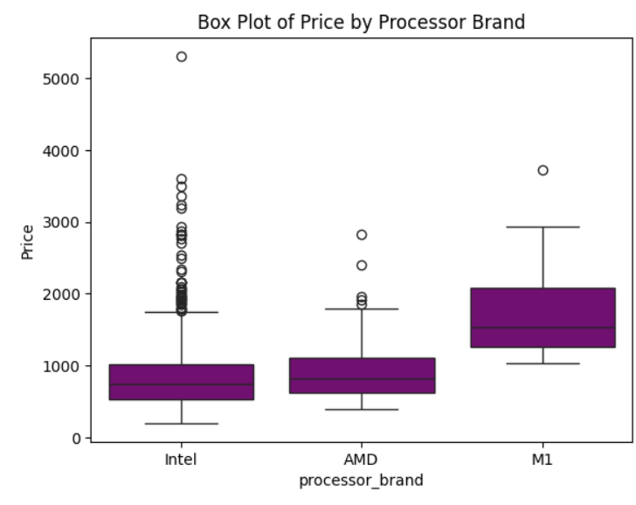
Processor Brand Price Impact
1
Intel
Intel processors show a wide price range, covering budget to premium.
2
AMD
AMD processors tend to be in more affordable laptops.
3
M1
Apple's M1 chip is exclusively in higher-priced MacBooks.

Slide 12
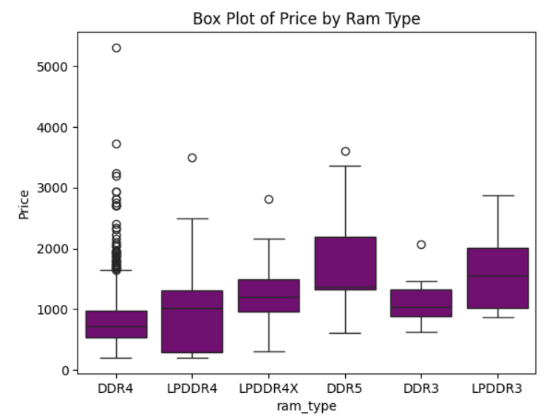
RAM Type Price Comparison
DDR4 RAM is most common and spans a wide price range. LPDDR4 is found in some premium models.

Slide 13
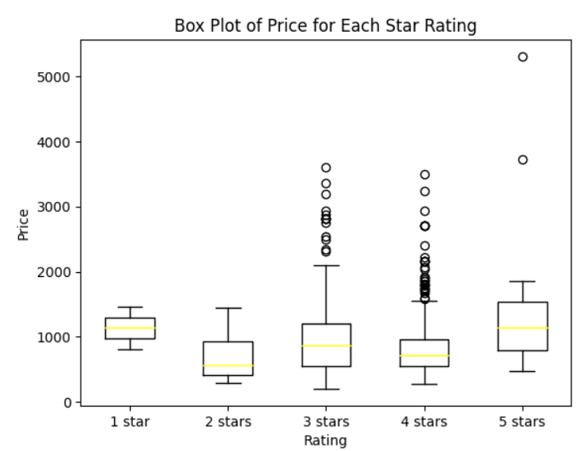
Price by Star Rating
1
5-Star Premium
5-star rated laptops tend to be the most expensive.
2
Mid-Range Ratings
3 and 4-star laptops cover a wide price range.
3
Budget Options
1 and 2-star laptops are generally the most affordable.

Slide 14
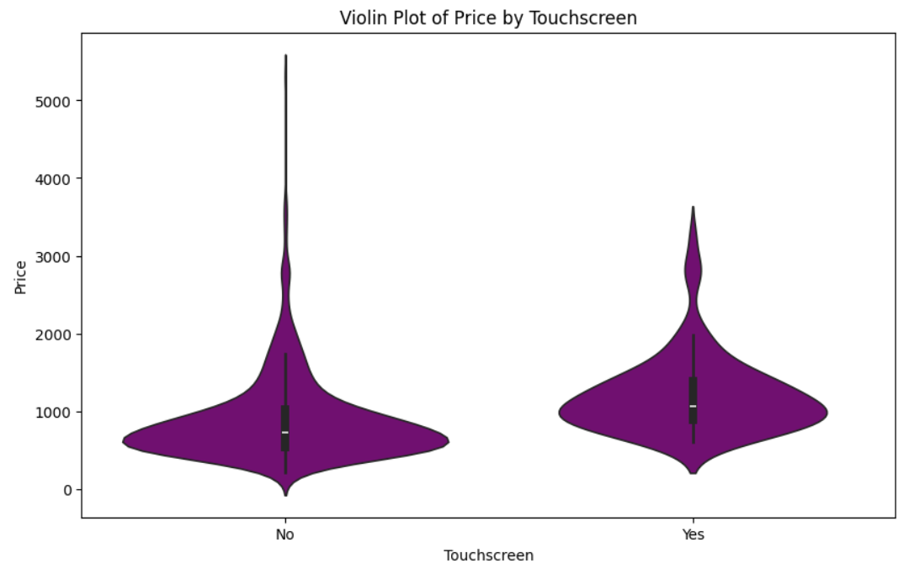
Touchscreen Price Impact
Touchscreen laptops tend to be more expensive than non-touchscreen models. The price distributions show clear differences.

Slide 15
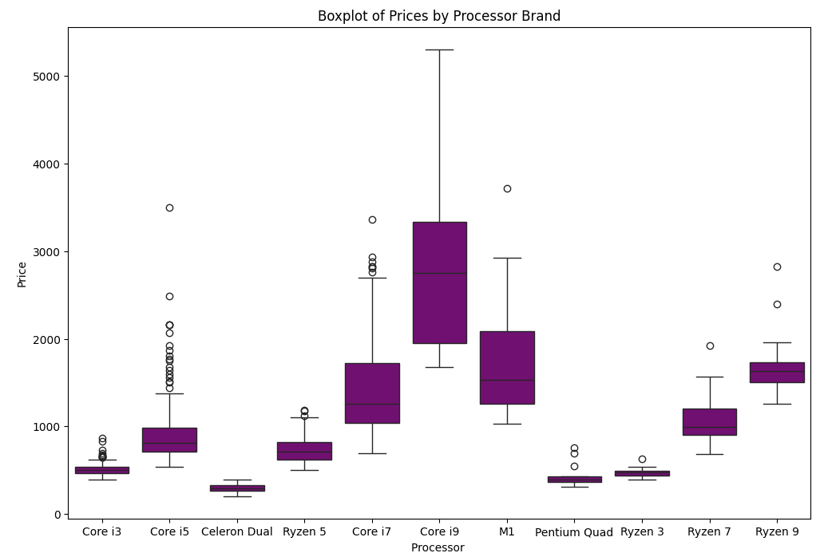
Processor Models and Pricing
1
High-End
Core i9 and Core i7 processors are in the most expensive laptops.
2
Mid-Range
Core i5 covers a wide price range in the middle.
3
Budget
Celeron and Pentium processors are in the most affordable laptops.

Slide 16
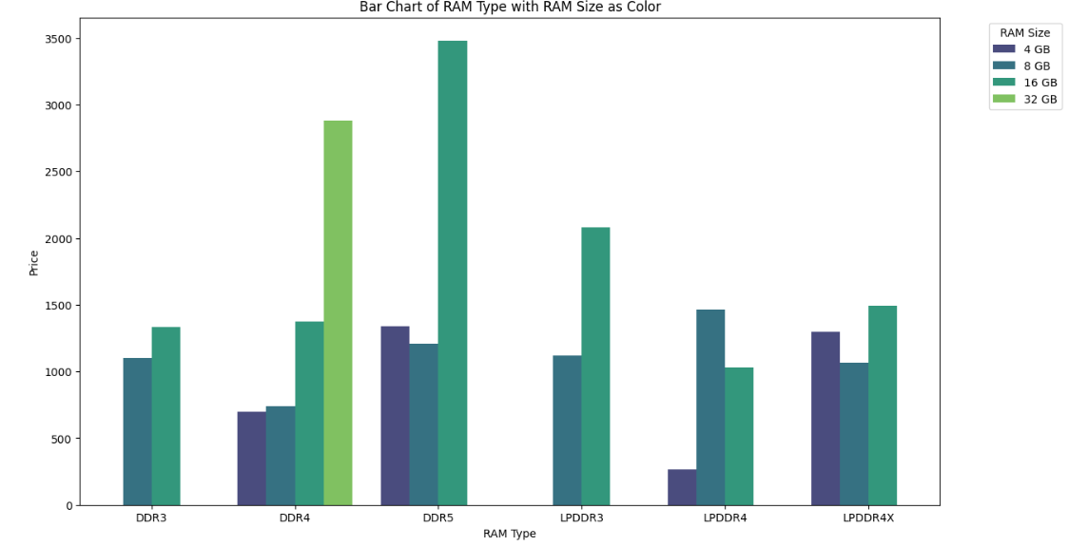
RAM Size and Type Pricing
Larger RAM sizes correlate with higher prices. DDR4 is most common across all sizes.

Slide 17
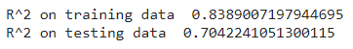
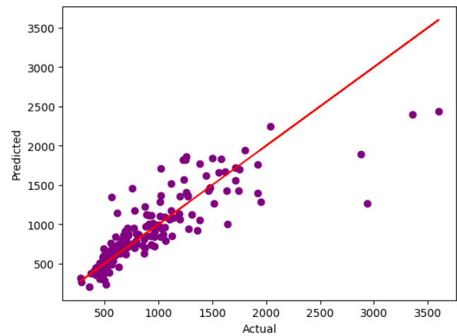
Linear Regression Model
1
R-squared: 0.70
The model explains 70% of price variance on test data.
2
RMSE: $288
Root mean square error shows average prediction deviation.
3
Visualization
Scatter plot shows predicted vs actual prices.

Slide 18

Model Comparison
Model
R-squared
RMSE
Ridge
0.71
$284
Lasso
0.71
$286
Decision Tree
0.39
$414
Gradient Boosting
0.69
$296
XGBoost
0.73
$274

Slide 19

XGBoost Model Performance
XGBoost outperformed other models with an R-squared of 0.73 and RMSE of $274.

Slide 20

XGBoost Hyperparameter Tuning
1
Best Parameters
n_estimators: 100, learning_rate: 0.1, max_depth: 5, subsample: 0.8
2
Improved R-squared
Tuning increased R-squared to 0.75
3
Reduced RMSE
RMSE decreased to $263.55

Slide 21
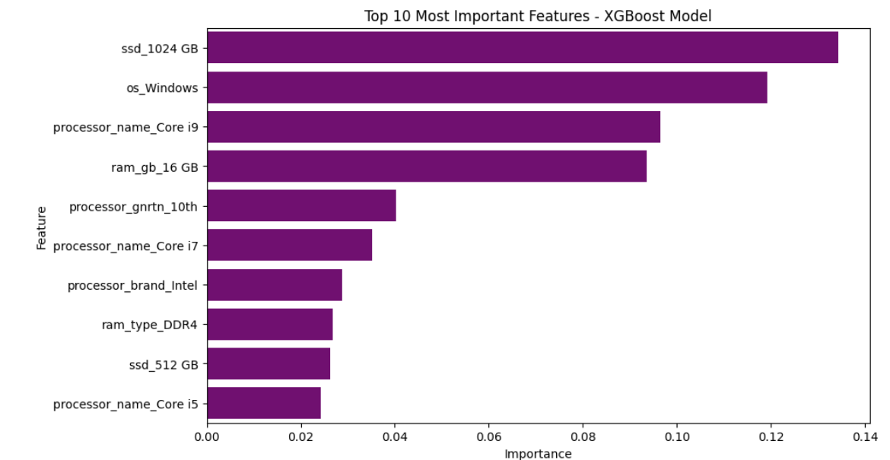
Top 10 Important Features
1
Storage
1TB SSD is the most important feature.
2
Operating System
Windows OS is the second most important.
3
Processor
Core i9 and Core i7 are highly influential.

Slide 22

Storage Impact on Price
Larger SSD capacity strongly correlates with higher laptop prices. 1TB SSDs are in premium models.

Slide 23

Operating System Influence
Windows laptops span a wide price range. MacOS devices are consistently in the premium segment.

Slide 24

Processor Impact on Pricing
Higher-end processors like Core i9 and i7 are strong indicators of premium laptop pricing.

Slide 25

Conclusion and Recommendations
1
Key Factors
SSD capacity, OS, and processor type strongly influence laptop prices.
2
Model Performance
XGBoost with tuning provides good price predictions (R-squared 0.75).
3
Future Work
Collect more data on high-end laptops to improve predictions.

